Slide 1
CS61B
Lecture 33: Software Engineering III
Candy Crush and Friends
The Ledger of Harms
Your Life

Slide 2
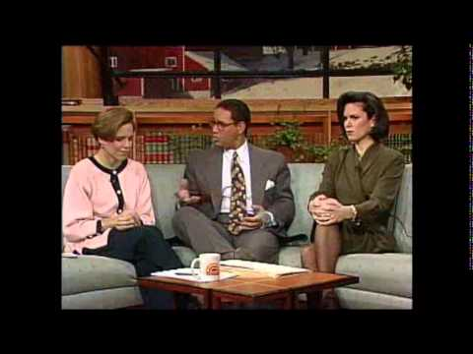
Overview
Software has completely reshaped society in my lifetime.
Today, we’ll discuss your role in the future we’re creating.
1994
Today Show

Slide 3
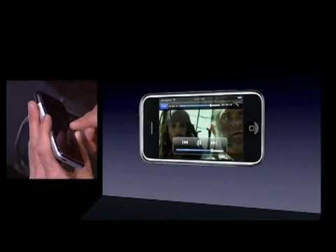
2007
Notes:
46 seconds in

Slide 4
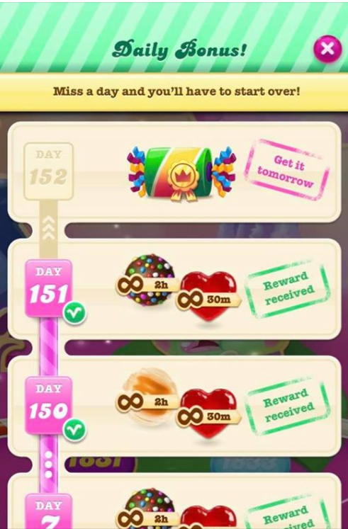
Candy Crush
The mobile game Candy Crush tracks the number of days you have played in a row.
Every consecutive day gets you a reward.
Progress indicator.
Up to 2 hours worth of a special item for that day that makes the game more fun.
If you miss a day, the counter resets.
Why does this feature exist in Candy Crush?
Encourages you to engage every day.

Slide 5
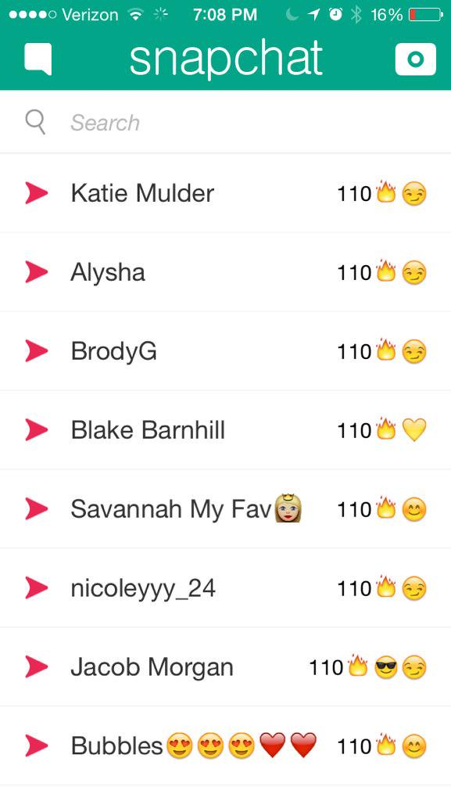
Snapchat
Similarly, for every day that you and a friend communicate on snapchat, your snap streak is extended by one day.
Why does this feature exist in Snapchat?
To encourage engagement.

Slide 6
Snapstreaks and Candy Crush Streak
What positive impacts do these features have on the world?
Encourages users to use the platform (neutral), but also connect with others!
Help maintain friendships.
Keeps kids off the streets -- if you’re snapchatting, you can’t be up to no good tipping over cows and spraypainting buildings.
It increases the impact of the company on the world.
Provides some happiness. Free dopamine.
Helps reduce isolation and provides a sense of meaning.
What negative impacts do these features have on the world?
It increases the impact of the company on the world.

Slide 7
Snapstreaks and Candy Crush Streak
What negative impacts do these features have on the world?
It increases the impact of the company on the world.
Huge time sink, bad use of our precious finite time.
Encourages addictive behavior.
Creates a new landscape for mutual hostility: WHY DIDNT YOU REPLY MY SNAPSTREAK!!
Discouraged by not measuring up with acquaintances.
FOMO about what people are actually doing.
Less rich experience than real life. Discourages higher quality reaction.
Potential damage to your dang eyes by looking at your phone (?).
False sense of accomplishment.
Discourages use of more useful features in the platform.
Constant mental drag. Have to do it EVERY day.
Discourages company from doing better for the world.
Locks people into specific platforms.

Slide 8
Snapstreaks and Candy Crush Bonuses
Are these features net positives for the world?
Overall positive: The more these platforms exist, the more we are aware of potential downfalls. We get inoculated as a species against potential harm.
Neutral but leaning positive: In our coronavirus universe, we need connection. Snapstreaks encourage connnection.
Slightly positive: Some people say ‘there are more productive hobbies’, but if you’re happy with snapchat, don’t let moral scolds judge.
The existence of snapstreaks encourages us to think of other interesting twists on the idea.
Neutral: Positive to encourage communication, but there are of course many dangers about how the platform can be used negatively.
Net negative: Many people have the potential to use it to connect, but lots of people are just looking for the dopamine rush. These mechanisms are exploited glitches in our brains. Seems like a bad use of time. Discourages creativity and connect genuinely.
Small negative at best: Our enumerated positives and negatives skew negative. Motivated communication is not genuine. Can’t escape cynical judgment regarding dopamine rush.

Slide 9
More Generally
Are Candy Crush/and Snapchat net positives for the world?

Slide 10
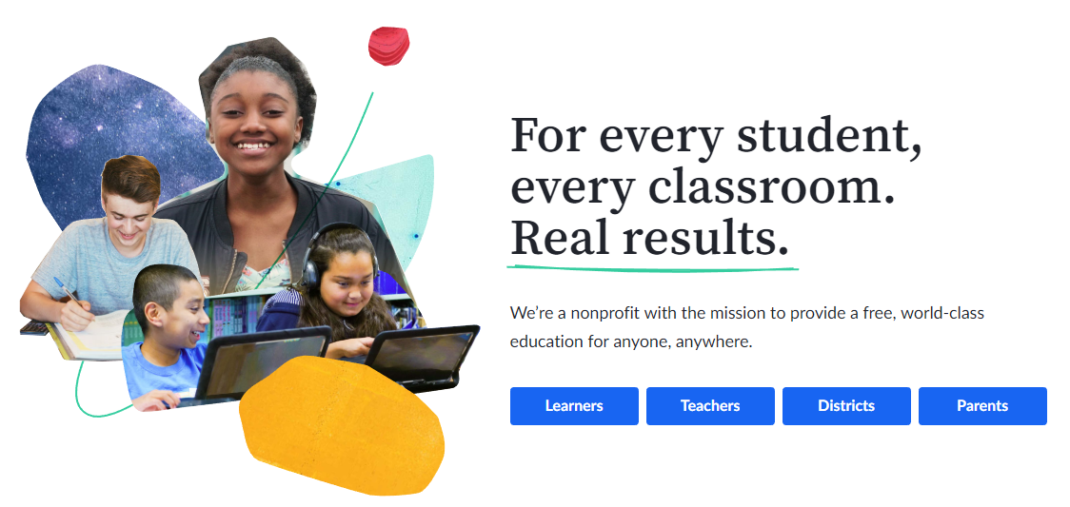
Khan Academy
I’m assuming you’re familiar with Khan Academy: https://www.khanacademy.org/.
… but just in case you’re not, let’s check it out.

Slide 11
Khan Academy
What positive impacts does Khan Academy have on the world?
Vastly increases accessibility to education.
Allows for mastery learning: Can iterate until you understand something.
Allows you to explore topics beyond your formal schooling.
Gamifies learning. Confetti when you get problems right!
Badges and points. Also encouraging.
Draw on expertise of the entire world of teachers in theory.
Massive FREE bank of resources for teachers.
What negative impacts does Khan Academy have on the world?
Gamifies learning. Motivation becomes extrinsic. You may just learn how to do things without understanding the underlying thinking.
Discourages community by letting you learn from home alone.

Slide 12
Khan Academy
What negative impacts does Khan Academy have on the world?
Gamifies learning. Motivation becomes extrinsic. You may just learn how to do things without understanding the underlying thinking.
Reward for kids drawing. Other kids not rewarded for drawing. Rewarded kids ended up not liking the activity as much as the ones who did it just for fun. Probably applies to all forms of learning.
Discourages community by letting you learn from home alone.
Undermines value of beating your head against a problem -- you never get truly stuck, which is important for learning.
Use Khan Academy to cheat on exams!
Enables lazy teachers.

Slide 13
Khan Academy
What negative impacts does Khan Academy have on the world?
Encourages shallow learning. Good for mechanical problems. Then when you go to harder problems you realize you didn’t get it all.
Might dissuade people from higher education or higher quality education.
Inconsistent learning environment. May conflict with real life schooling.
In physics: Watch Khan Academy videos, but if you don’t understand the videos, you can’t ask questions. You rely on the source video being perfect / aligned with your way of thinking.
Discourages group discussion problem solving.
Furthers gap between students who have access to internet and those that don’t. Leaves non-internet access students behind.

Slide 14
Khan Academy
What negative impacts does Khan Academy have on the world?
D

Slide 15
Khan Academy
Is Khan Academy a net positive?
Absolutely.

Slide 16
Workplace Preference
What are some reasons people might prefer working at King (developer of Candy Crush) over Khan Academy?
Games are fun to work on / interest in game development.
Software engineering at Khan Academy is likely to be database back-end work, whereas the work on a game might just be more intellectually stimulating.
Candy Crush is likely to pay far more.
Human-centric design person might prefer the game, because you get to figure out how to addict people.
If you’re just tired of school, maybe going and working for online school feels too close to home.

Slide 17
Revenues
King and Snapchat generate enormous amounts of revenue.
Note: Even with all this revenue, Snapchat is still not profitable (net loss of 200 million in 3rd quarter of 2020).
 | Revenues | Profits | # Employees | Revenue / Employee
King (2019) | 2 billion | Unreported* | ~2,000 | ~$1,000,000
Snapchat (2019) | 1.7 billion | -0.8 billon | ~2,734 | ~$600,000
Khan Academy | 0.037 billion (includes gifts) | N/A | 205 (including 11 dogs, 7 cats) | N/A
* King is owned by Blizzard-Activision and yearly report doesn’t give profit for King as a unit.
Sources: Link, Link, Link, Link, Link

Slide 18
The Ledger of Harms

Slide 19
Concerns Expressed by Tech Leaders
“I think we have created tools that are ripping apart the social fabric of how society works.” - Chamath Palihapitiya (early executive at Facebook)
“God only knows what it[Facebook]’s doing to our children’s brains.” - Sean Parker (the Napster guy)
“The technologies we were most excited about 10 years ago are now implicated in just about every catastrophe of the day.” - Farhad Manjoo (technology journalist)
“These are our lives. These are our precious, finite, mortal little lives. The idea that we are spending them distracted, not accomplishing the thing that we’re trying to do, is just painful. It’s crazy.” - Justin Rosenstein, creator of the Like button and founder of Asana
““Facebook appeals to your lizard brain — primarily fear and anger,” he said. “And with smartphones, they’ve got you for every waking moment.”” -Roger McNamee (early investor in many tech companies, interesting guy)

Slide 20
My Thoughts
Technology companies do inflict significant negative externalities upon society.
Most of them are still a net positive, e.g. I personally use and enjoy Facebook, though I’m on hiatus until this bizarre election is totally over.
My personal sense is that these are largely unintended consequences by well intentioned people.
Yes, there are some bad actors, but I don’t think they are common.
Workers and executives at these companies do care.
… but money does skew people’s perspective in strange ways.

Slide 21
The Center for Humane Technology and the Ledger of Harms
The Center for Humane Technology was founded by current and former tech workers to raise awareness and try to combat harmful side effects of internet tech platforms.
In 2018, they created a Ledger of Harms “collect those negative impacts of social media and mobile tech that do not show up on the balance sheets of companies, but on the balance sheet of society.”
It is “aimed at guiding rank-and-file engineers who are concerned about what they are being asked to build.” [Link]

Slide 22
Ledger of Harms
The Ledger:
Making Sense of the World: Misinformation, conspiracies, fake news.
Attention: Loss of ability to focus without distraction.
Physical and Mental Health: Stress, loneliness, addiction, risky behavior.
Relationships: Less empathy, more confusion and misinterpretation.
Politics and Elections: Propaganda, distorted dialogue, disrupted democratic processes.
Systemic Oppression: Amplification of discrimination.
Children: Developmental delays, suicide, physical/mental/social changes.,
Do Unto Others: Tech employees limit tech usage in their own homes.
For each category, they provide research and citations for potential harms.

Slide 23
Making Sense of the World
“64% of all extremist group joins are due to our recommendation tools...our recommendation systems grow the problem”, noted an internal Facebook presentation in 2016. Yet repeated attempts to counteract this have been repeatedly ignored, diluted, or deliberately shut down by senior Facebook officers, according to a 2020 Wall Street Journal investigation.”
“Fake news spreads six times faster than true news. According to researchers, this is because fake news grabs our attention more than authentic information: fake news items usually have a higher emotional content and contain unexpected information which inevitably means that they will be shared and reposted more often.”
“45% of tweets about coronavirus are from bots spreading fake information, according to research from Carnegie Mellon University.”
“2 minutes of exposure to a conspiracy theory video reduces people’s pro-social attitudes (such as their willingness to help others), as well as reducing their belief in established scientific facts.”

Slide 24
Attention
“The presence of a smartphone, even when off, can reduce cognitive capacity by taxing the attentional resources that reside at the core of both working memory capacity and fluid intelligence.”
“72% of teens and 48% of parents feel the need to immediately respond to texts, social-networking messages, and other notifications.”
“1 hour per day is the amount of time most Americans spend dealing with distractions and then getting focused and back on track each day, which comes to a grand total of 5 full weeks in a year.”
“Almost 90% of 290 undergraduates reported feeling "phantom vibrations," which were experienced an average of once every two weeks.”

Slide 25
Mental Health
“30% of 18-44 year olds feel anxious if they haven’t checked Facebook in the last 2 hours.”
“1 month away from Facebook leads to a significant improvement in emotional well-being. In an experimental study of over 1,600 American adults (who normally used Facebook for up to an hour each day), deactivating Facebook accounts led to a significant increase in emotional well-being (including a reduction in loneliness and an increase in happiness), as well as a significant reduction in political polarization.”
“In just 3 years, there has been a quadrupling in the number of plastic surgeons with patients undergoing cosmetic surgery for the sake of looking good on social media (from 13% in 2016 to 55% in 2019).“

Slide 26
Relationships
“Even the mere presence of smartphone can disrupt the connection between two people, having negative effects on closeness, connection, and conversation quality.”
“People overestimate their ability to correctly interpret sarcasm, humor, or sincerity over text communication, and this means people tend to believe they can communicate over e-mail more effectively than they actually can.”
“50% of Americans report that their partner is often or sometimes distracted by their devices when they are trying to talk to them.
“89% of cellphone users admit to using their phones during their last social gathering.”

Slide 27
Politics and Democracy
“More fake political headlines were shared on Facebook than real ones during the last 3 months of the 2016 US elections.”
“Exposure to a fake political news story can rewire your memories: in a study, where over 3,000 voters were shown fake stories, many voters later not only “remembered” the fake stories as if they were real events but also "remembered" additional, rich details of how and when the events took place.”
“Fake news stories posted before the 2016 US elections were still in the top 10 news stories circulating across Twitter almost 2 years later, indicating the staying power of such stories and their long-term impact on ongoing political dialogue.”

Slide 28
Systemic Oppression
“Russia's IRA spread false information designed to create outrage about Black Lives Matter and deepen social division in the US. Research indicates that one of the IRA's major strategies was to use social media platforms to target conservative groups who supported the police or veterans and specifically feed them misinformation about BLM.”
“With over 800 million users, TikTok promotes itself as a place for self-expression and unrestricted creativity, yet its internal documents reveal a policy of downgrading content from users who do not fit normative ideals of gender, race, class, sexuality, or able-bodiedness, with moderators urged to censor users with "abnormal body shape", "too many wrinkles", or whose environment shows signs of poverty such as "cracks in the wall" or "old decorations".”

Slide 29
Children
“58 minutes per day is the average amount of time 2-4 years old spend on mobile devices.“
“In a longitudinal study tracking over 200 children from the age of 2 years to 5 years old, children with higher levels of screen time showed greater delays in development across a range of important measures, including language, problem-solving, and social interaction. Analyses indicated that the level of screen time was significantly linked to the specific level of developmental delay 12 -14 months later. “

Slide 30
Your Life

Slide 31
The Power of Software
Unlike other engineering disciplines, software is effectively unconstrained by the laws of physics.
Programming is an act of almost pure creativity!
The greatest limitation we face in building systems is being able to understand what we’re building!

Slide 32
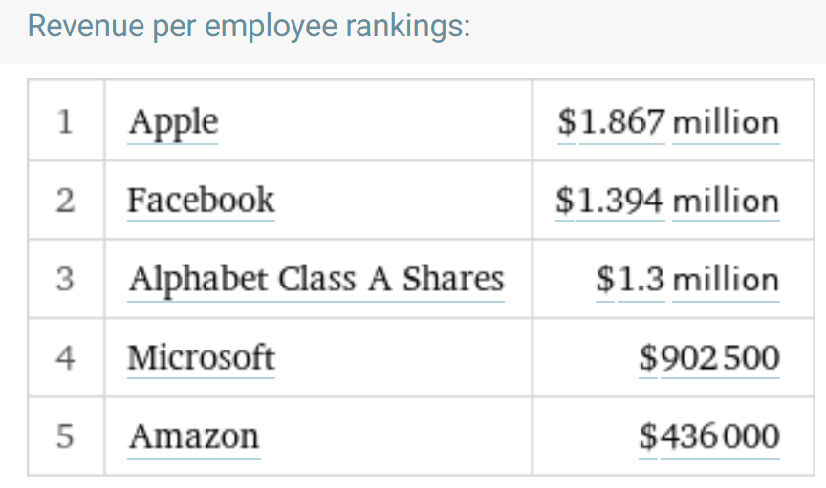
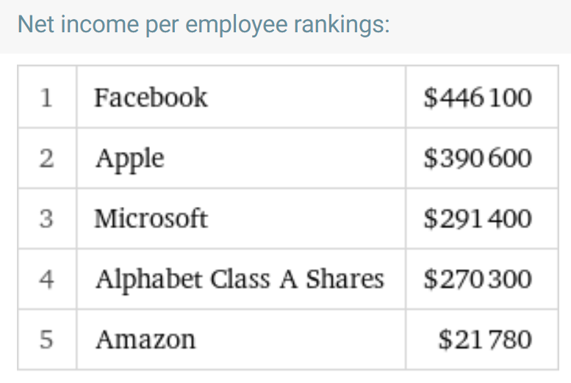
The Limiting Reagent
You are a rare commodity.
The skills you are building will be in high demand from companies, non-profits, government agencies, educational institutions, and more.
The choice of how to spend your career is yours.
Sources: Link, Link

Slide 33
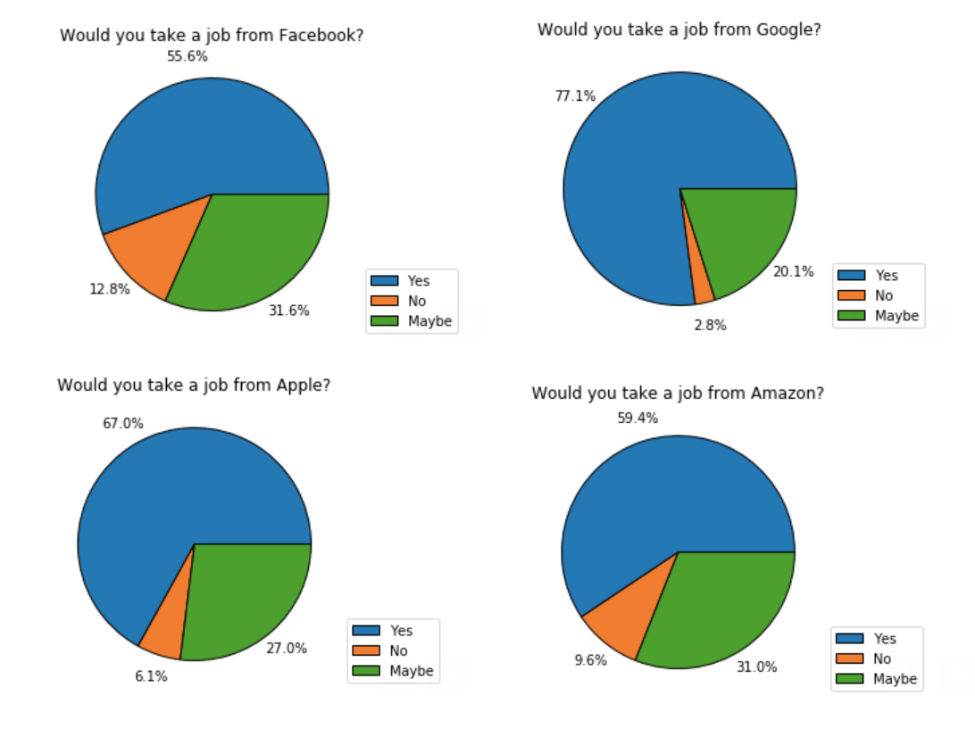
Some 61B Data (2019)

Slide 34
Steering the Course
Quite a lot of you will likely end up working at some sort of technology company at some point in your life.
There’s nothing (IMO) wrong with working at profit driven tech companies.
Please do realize that even as a rank and file employee, you have the power to effect change, particularly if you are paid in stock (because then you are a partial owner).
Let’s see some examples.

Slide 35
Example 1: Google and the Censored Chinese Search Engine
From 2006 to 2010, Google operated a censored version of Google in China.
Withdrew in 2010 in response to cyber attacks by the Chinese government on users of Google’s services: “These attacks and the surveillance they have uncovered--combined with the attempts over the past year to further limit free speech on the web--have led us to conclude that we should review the feasibility of our business operations in China. We have decided we are no longer willing to continue censoring our results on Google.cn.”
In Oct 2018, leaked documents published in The Intercept revealed a secret project by Google to re-enter the Chinese market.
This new search engine would be censored, and also allow government officials to hypothetically track Chinese residents making undesired queries.

Slide 36
Example 1: Google and the Censored Chinese Search Engine
Some employee responses:
After the leaks, access within the company to documents related to the project were curtailed: “Everyone’s access to documents got turned off, and is being turned on [on a] document-by-document basis,” said one source. “There’s been total radio silence from leadership, which is making a lot of people upset and scared. … Our internal meme site and Google Plus are full of talk, and people are a.n.g.r.y.” [Link]
Over 1400 employees signed a letter demanding more transparency, and at least five employees resigned in protest [Link].

Slide 37
Example 1: Google and the Censored Chinese Search Engine
Jack Poulson (a senior scientist who resigned): (Link)
“There are serious worldwide repercussions to this... what are Google’s ethical red lines? We already wrote some down, but now we seem to be crossing those.”
Poulson said that he “very much agree[s] with the case Sergey made in 2010. That’s the company I joined, the one that was making that statement.” If the anti-censorship stance is shifting, he said, then he could no longer “be complicit as a shareholder and citizen of the company.”
Ultimately, in response to employee outcry, the project was cancelled [Link].

Slide 38
Example 2: Amazon and Climate Change [Link]
18 months + a few weeks ago, 6,772+ employees at Amazon publicly signed a letter demanding better responses to climate change by Amazon.
Specifically, they want the company to adopt a shareholder resolution (link) to study how the company will adapt to and reduce its contribution to climate change.
“Amazon is not a mere victim of climate change—its operations contribute significantly to the problem… Coal still powers Amazon data centers. Diesel, gasoline, and jet fuel still power package delivery.”
“Amazon has the resources and scale to spark the world’s imagination and redefine what is possible and necessary to address the climate crisis.”
“Like other shareholders, they can file a resolution urging a particular corporate change that investors vote on at a company’s annual meeting.”

Slide 39
Time
You get some number of decades on the planet.
Each week is 168 hours.
~40 hours of work.
~56 hours of sleep.
~72 hours for everything else.
Spend your time wisely, in both your career and personal life.
Anecdotally, most of you will have much more free time after college than you do now.

